Slide 1



Geometric Transformations
2D and 3D

Slide 2
Overview
Examples of transformations and their uses
Points and vectors
A special kind of transformation
The dot product and matrix product
Matrix transformations
Composition of matrix transformations
Inverse transformations; inverse matrices
Building specific transformations
What about translation

Slide 3
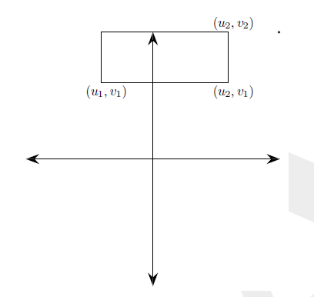
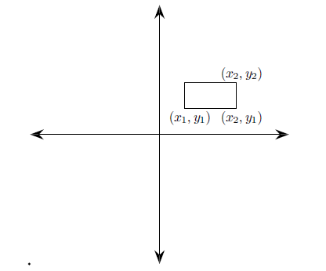
Windowing Transformations (CG terminology)
Windowing transformation maps contents of 2D clip rectangle (“window”) to a “viewport” rectangle on the screen, e.g., interior canvas (“client area”) of a window manager’s window; also called window-to-viewport transformation
Sends rectangle with bounding coordinates (u₁ , v₁), (u₂ , v₂) to (x₁ , y₁), (x₂ , y₂)

Slide 4

Camera transformation
Take any point P in the view frustum and compute where P “projects to” on the view plane
In our baby renderer, we did this with the view plane being $z=−1$.
The transformation ended up being $f\left(x,y,z\right)=(−\frac{x}{z},−\frac{y}{z},−1)$.

Slide 5

So what is a transformation?
It’s a function from one space to another (or itself)
Typically used for 2- and 3-dimensional functions instead of 1-dimensional ones
Sometimes the domain isn’t all of 3-space, but some limited portion
Example: our “camera projection” was only defined for points in the frustum
If we tried to compute $f\left(x,y,z\right)=\left(−\frac{x}{z},−\frac{y}{z},−1\right)$ for a point with $z=0$, it’d make no sense!

Slide 6
Overview
Examples of transformations and their uses
Points and vectors
A special kind of transformation
The dot product and matrix product
Matrix transformations
Composition of matrix transformations
Inverse transformations; inverse matrices
Building specific transformations
What about translation

Slide 7
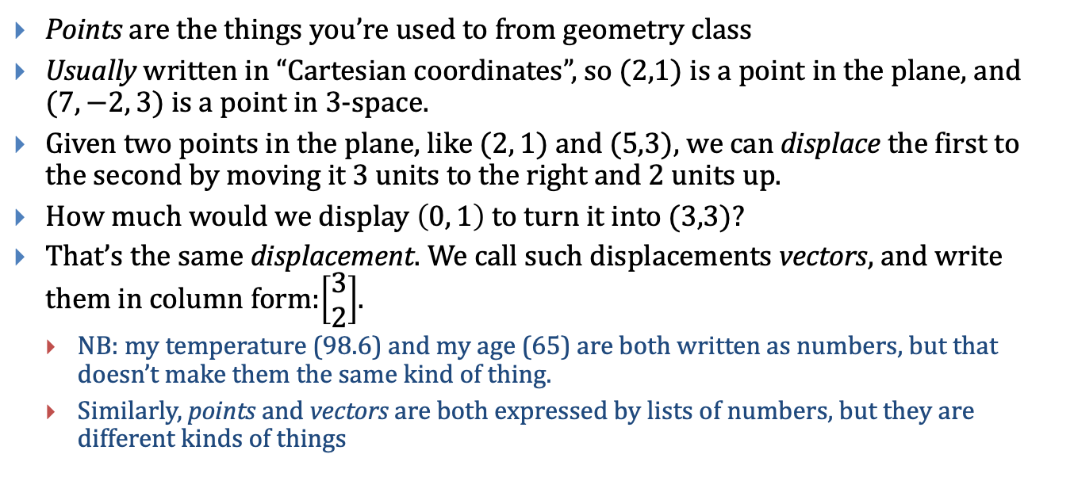
Points and Vectors (1)
Points are the things you’re used to from geometry class
Usually written in “Cartesian coordinates”, so $(2,1)$ is a point in the plane, and $(7, −2, 3)$ is a point in 3-space.
Given two points in the plane, like $(2, 1)$ and $(5,3)$, we can displace the first to the second by moving it 3 units to the right and 2 units up.
How much would we display $\left(0, 1\right)$ to turn it into $(3,3)$?
That’s the same displacement. We call such displacements vectors, and write them in column form:$\left[\begin{aligned}3 \\ 2\end{aligned}\right]$.
NB: my temperature (98.6) and my age (65) are both written as numbers, but that doesn’t make them the same kind of thing.
Similarly, points and vectors are both expressed by lists of numbers, but they are different kinds of things

Slide 8
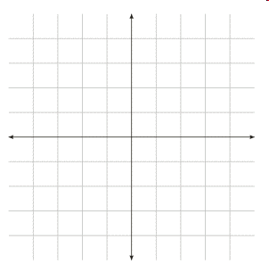
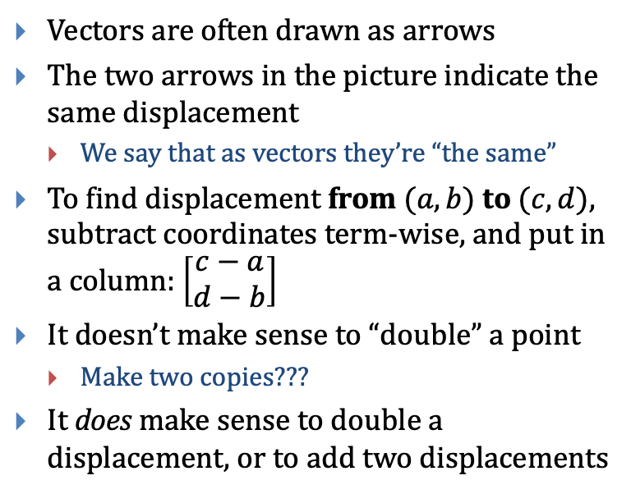
Points and Vectors (2)
Vectors are often drawn as arrows
The two arrows in the picture indicate the same displacement
We say that as vectors they’re “the same”
To find displacement from $(a,b)$ to $(c,d)$, subtract coordinates term-wise, and put in a column: $\left[\begin{aligned}c−a \\ d−b\end{aligned}\right]$
It doesn’t make sense to “double” a point
Make two copies???
It does make sense to double a displacement, or to add two displacements
(3,5)
(1,2)
(3,3)
(1,0)

Slide 9
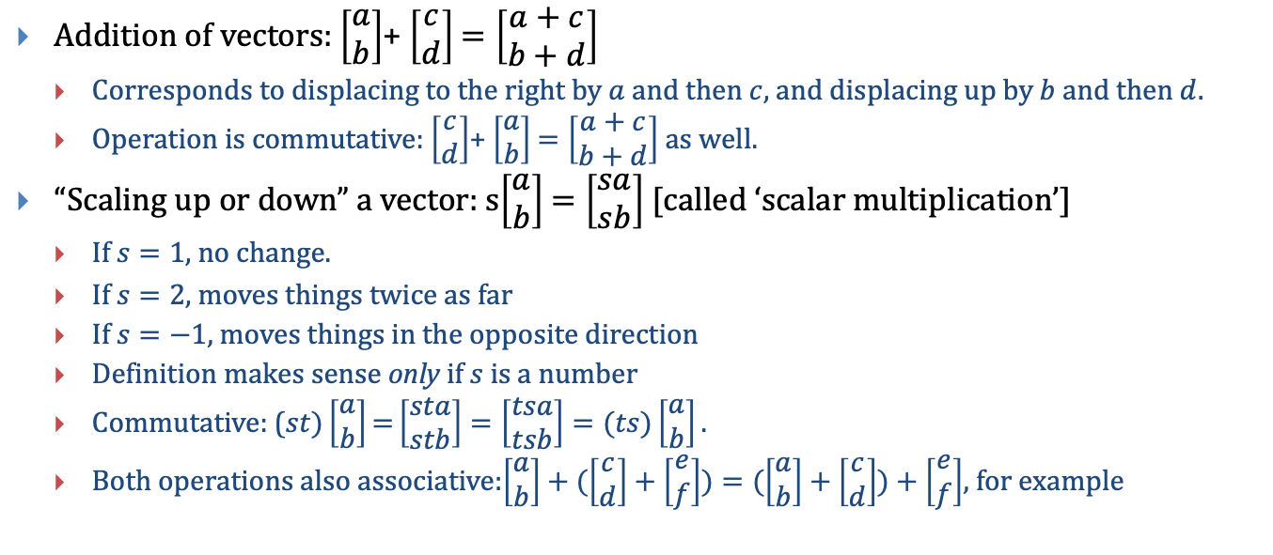
Operations on vectors
Addition of vectors: $\left[\begin{aligned}a \\ b\end{aligned}\right]$+ $\left[\begin{aligned}c \\ d\end{aligned}\right]$ $=\left[\begin{aligned}a+c \\ b+d\end{aligned}\right]$
Corresponds to displacing to the right by $a$ and then $c$, and displacing up by $b$ and then $d$.
Operation is commutative: $\left[\begin{aligned}c \\ d\end{aligned}\right]$+ $\left[\begin{aligned}a \\ b\end{aligned}\right]$ $=\left[\begin{aligned}a+c \\ b+d\end{aligned}\right]$as well.
“Scaling up or down” a vector: s$\left[\begin{aligned}a \\ b\end{aligned}\right]$ $=\left[\begin{aligned}sa \\ sb\end{aligned}\right]$ [called ‘scalar multiplication’]
If $s=1$, no change.
$\text{If} s=\text{2}\text{, }\text{moves} \text{things} \text{twice} \text{as} \text{far}$
If $s=−1$, moves things in the opposite direction
Definition makes sense only if $s$ is a number
Commutative: ($st)\left[\begin{aligned}a \\ b\end{aligned}\right]\text{=}\left[\begin{aligned}sta \\ stb\end{aligned}\right]=\left[\begin{aligned}tsa \\ tsb\end{aligned}\right]=(ts)\left[\begin{aligned}a \\ b\end{aligned}\right].$
Both operations also associative:$\left[\begin{aligned}a \\ b\end{aligned}\right]+(\left[\begin{aligned}c \\ d\end{aligned}\right]+\left[\begin{aligned}e \\ f\end{aligned}\right])=(\left[\begin{aligned}a \\ b\end{aligned}\right]+\left[\begin{aligned}c \\ d\end{aligned}\right])+\left[\begin{aligned}e \\ f\end{aligned}\right]$, for example

Slide 10
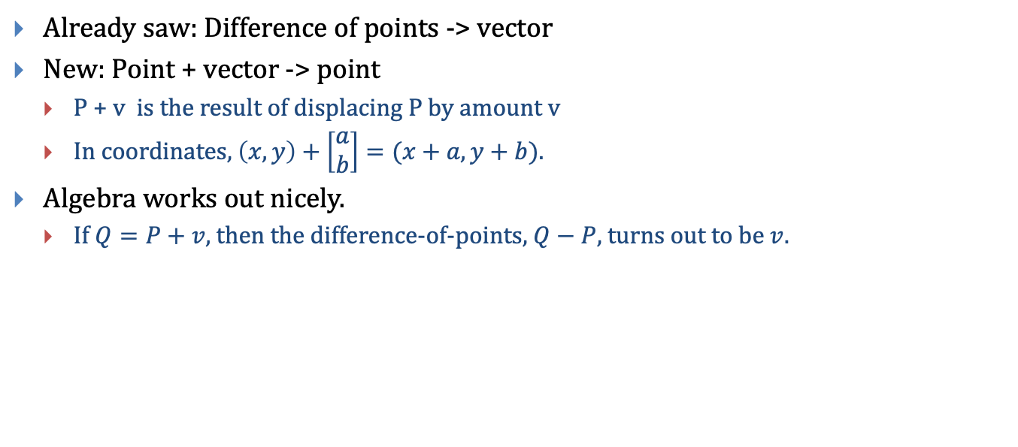
Mixing points and vectors
Already saw: Difference of points -> vector
New: Point + vector -> point
P + v is the result of displacing P by amount v
In coordinates, $\left(x, y\right)+\left[\begin{aligned}a \\ b\end{aligned}\right]=(x+a, y+b)$.
Algebra works out nicely.
If $Q=P+v$, then the difference-of-points, $Q−P$, turns out to be $v$.

Slide 11
Overview
Examples of transformations and their uses
Points and vectors
A special kind of transformation
The dot product and matrix product
Matrix transformations
Composition of matrix transformations
Inverse transformations; inverse matrices
Building specific transformations
What about translation

Slide 12
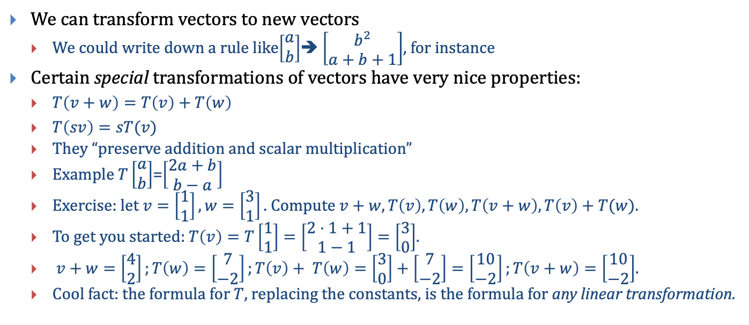
An important ways to transform vectors
We can transform vectors to new vectors
We could write down a rule like$\left[\begin{aligned}a \\ b\end{aligned}\right]$➔ $\left[\begin{aligned}b^{2} \\ a+b+1\end{aligned}\right]$, for instance
Certain special transformations of vectors have very nice properties:
$T\left(v+w\right)=T\left(v\right)+T\left(w\right)$
$T\left(sv\right)=sT(v)$
They “preserve addition and scalar multiplication”
Example $T\left[\begin{aligned}a \\ b\end{aligned}\right]$=$\left[\begin{aligned}2a+b \\ b−a\end{aligned}\right]$
Exercise: let $v=\left[\begin{aligned}1 \\ 1\end{aligned}\right], w=\left[\begin{aligned}3 \\ 1\end{aligned}\right].$ Compute $v+w, T\left(v\right), T\left(w\right), T\left(v+w\right), T\left(v\right)+T(w)$.
To get you started: $T\left(v\right)=T\left[\begin{aligned}1 \\ 1\end{aligned}\right]=\left[\begin{aligned}2⋅1+1 \\ 1−1\end{aligned}\right]=\left[\begin{aligned}3 \\ 0\end{aligned}\right]$.
$v+w=\left[\begin{aligned}4 \\ 2\end{aligned}\right];T\left(w\right)=\left[\begin{aligned}7 \\ −2\end{aligned}\right];T\left(v\right)+ T\left(w\right)=\left[\begin{aligned}3 \\ 0\end{aligned}\right]+\left[\begin{aligned}7 \\ −2\end{aligned}\right]=\left[\begin{aligned}10 \\ −2\end{aligned}\right];T\left(v+w\right)=\left[\begin{aligned}10 \\ −2\end{aligned}\right]$.
Cool fact: the formula for $T$, replacing the constants, is the formula for any linear transformation.

Slide 13
Overview
Examples of transformations and their uses
Points and vectors
A special kind of transformation
The dot product and matrix product
Matrix transformations
Composition of matrix transformations
Inverse transformations; inverse matrices
Building specific transformations
What about translation

Slide 14
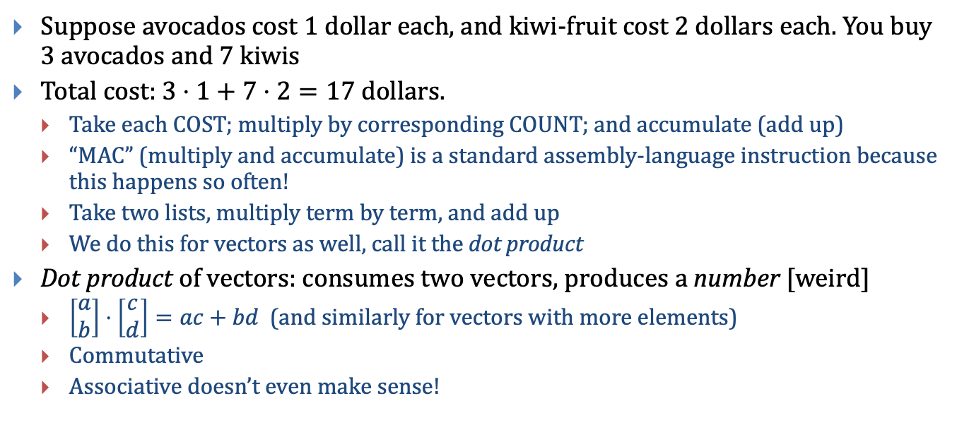
Dot product of vectors
Suppose avocados cost 1 dollar each, and kiwi-fruit cost 2 dollars each. You buy 3 avocados and 7 kiwis
Total cost: $3⋅1+7⋅2=17$ dollars.
Take each COST; multiply by corresponding COUNT; and accumulate (add up)
“MAC” (multiply and accumulate) is a standard assembly-language instruction because this happens so often!
Take two lists, multiply term by term, and add up
We do this for vectors as well, call it the dot product
Dot product of vectors: consumes two vectors, produces a number [weird]
$\left[\begin{aligned}a \\ b\end{aligned}\right]⋅\left[\begin{aligned}c \\ d\end{aligned}\right]=ac+bd$ (and similarly for vectors with more elements)
Commutative
Associative doesn’t even make sense!

Slide 15
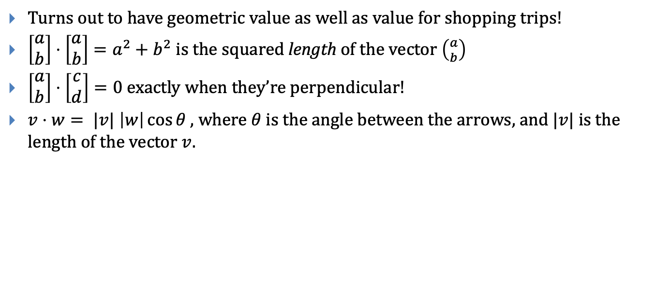
Dot products again
Turns out to have geometric value as well as value for shopping trips!
$\left[\begin{aligned}a \\ b\end{aligned}\right]⋅\left[\begin{aligned}a \\ b\end{aligned}\right]=a^{2}+b^{2}$ is the squared length of the vector $\left({a \atop b}\right)$
$\left[\begin{aligned}a \\ b\end{aligned}\right]⋅\left[\begin{aligned}c \\ d\end{aligned}\right]=0$ exactly when they’re perpendicular!
$v⋅w= |v| \left|w\right|\cos{θ}$, where $θ$ is the angle between the arrows, and $|v|$ is the length of the vector $v.$

Slide 16
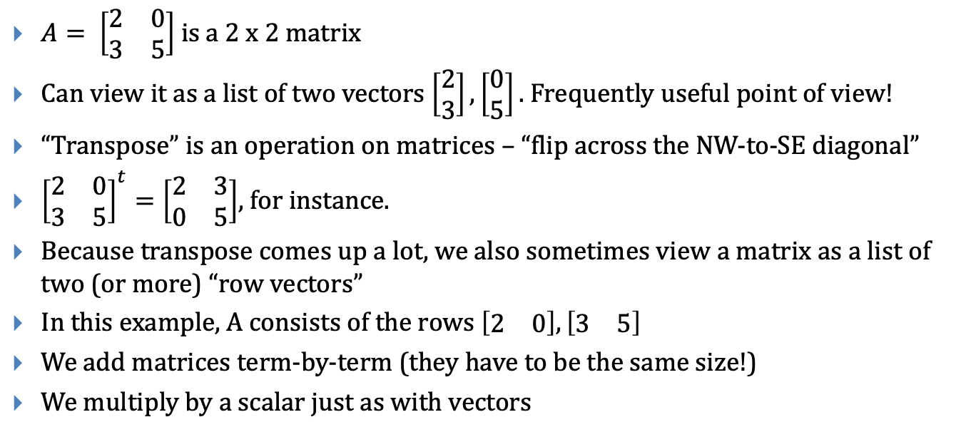
Vectors (in bracket form) are a special kind of matrix
$A= \left[\begin{matrix}2 & 0 \\ 3 & 5\end{matrix}\right]$ is a 2 x 2 matrix
Can view it as a list of two vectors $\left[\begin{aligned}2 \\ 3\end{aligned}\right],\left[\begin{aligned}0 \\ 5\end{aligned}\right].$ Frequently useful point of view!
“Transpose” is an operation on matrices – “flip across the NW-to-SE diagonal”
${\left[\begin{matrix}2 & 0 \\ 3 & 5\end{matrix}\right]}^{t}=\left[\begin{matrix}2 & 3 \\ 0 & 5\end{matrix}\right]$, for instance.
Because transpose comes up a lot, we also sometimes view a matrix as a list of two (or more) “row vectors”
In this example, A consists of the rows $\left[\begin{matrix}2 & 0\end{matrix}\right], \left[\begin{matrix}3 & 5\end{matrix}\right]$
We add matrices term-by-term (they have to be the same size!)
We multiply by a scalar just as with vectors

Slide 17

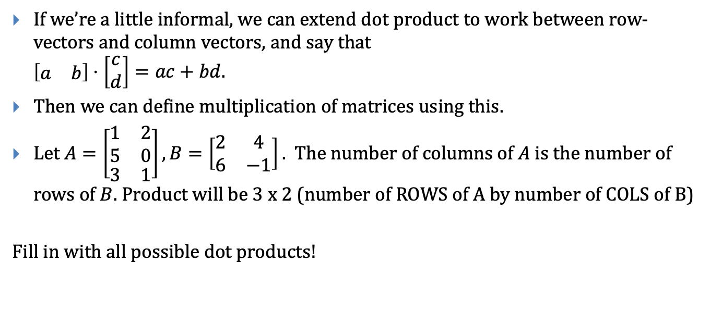



Matrix product
If we’re a little informal, we can extend dot product to work between row-vectors and column vectors, and say that $\left[\begin{matrix}a & b\end{matrix}\right]⋅\left[\begin{aligned}c \\ d\end{aligned}\right]=ac+bd$.
Then we can define multiplication of matrices using this.
Let $A=\left[\begin{aligned}\begin{matrix}1 & 2 \\ 5 & 0\end{matrix} \\ \begin{matrix}3 & 1\end{matrix}\end{aligned}\right], B=\left[\begin{matrix}2 & 4 \\ 6 & −1\end{matrix}\right].$ The number of columns of $A$ is the number of rows of $B$. Product will be 3 x 2 (number of ROWS of A by number of COLS of B)
Fill in with all possible dot products!
$$\left[\begin{matrix}2 & 4 \\ 6 & −1\end{matrix}\right]$$
$$\left[\begin{aligned}\begin{matrix}1 & 2 \\ 5 & 0\end{matrix} \\ \begin{matrix}3 & 1\end{matrix}\end{aligned}\right]$$
$$z$$
$$\left[\begin{aligned}\begin{matrix} & ?\end{matrix} \\ \begin{matrix}? & ? \\ ? & ?\end{matrix}\end{aligned}\right]$$

Slide 18

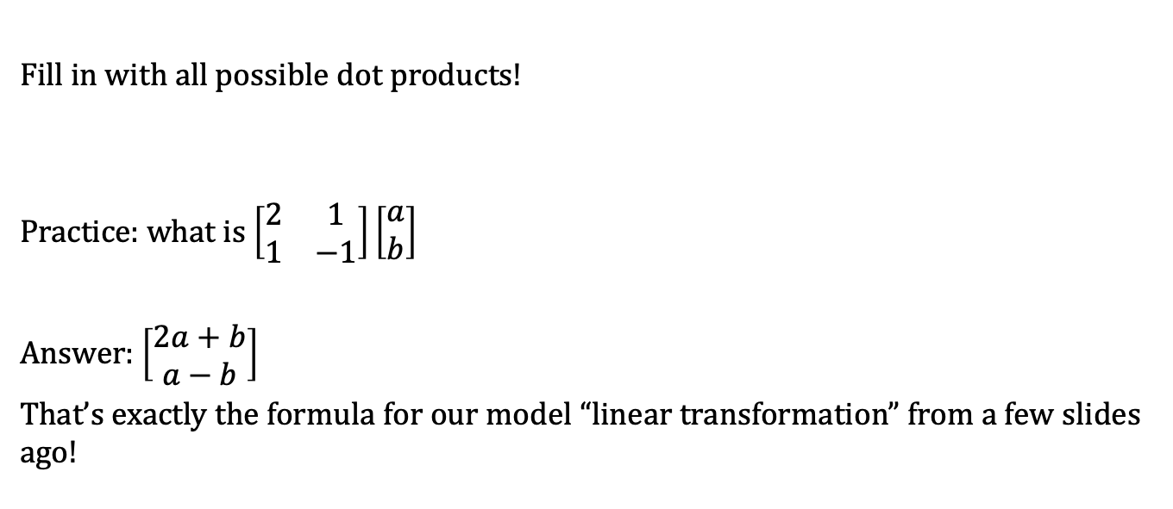
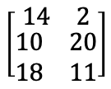

Matrix product
Fill in with all possible dot products!
Practice: what is $\left[\begin{matrix}2 & 1 \\ 1 & −1\end{matrix}\right]\left[\begin{aligned}a \\ b\end{aligned}\right]$
Answer: $\left[\begin{aligned}2a+b \\ a−b\end{aligned}\right]$
That’s exactly the formula for our model “linear transformation” from a few slides ago!
$$\left[\begin{matrix}2 & 4 \\ 6 & −1\end{matrix}\right]$$
$$\left[\begin{aligned}\begin{matrix}1 & 2 \\ 5 & 0\end{matrix} \\ \begin{matrix}3 & 1\end{matrix}\end{aligned}\right]$$
$$\left[\begin{aligned}\begin{matrix}14 & 2\end{matrix} \\ \begin{matrix}10 & 20 \\ 18 & 11\end{matrix}\end{aligned}\right]$$

Slide 19
Overview
Examples of transformations and their uses
Points and vectors
A special kind of transformation
The dot product and matrix product
Matrix transformations
Composition of matrix transformations
Inverse transformations; inverse matrices
Building specific transformations
What about translation

Slide 20
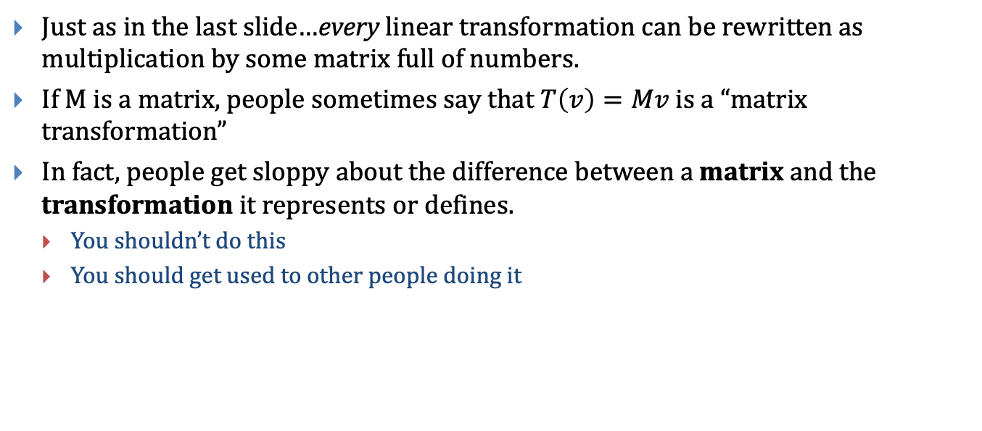
Slightly Amazing Fact
Just as in the last slide…every linear transformation can be rewritten as multiplication by some matrix full of numbers.
If M is a matrix, people sometimes say that $T\left(v\right)=Mv$ is a “matrix transformation”
In fact, people get sloppy about the difference between a matrix and the transformation it represents or defines.
You shouldn’t do this
You should get used to other people doing it

Slide 21
Overview
Examples of transformations and their uses
Points and vectors
A special kind of transformation
The dot product and matrix product
Matrix transformations
Composition of matrix transformations
Inverse transformations; inverse matrices
Building specific transformations
What about translation

Slide 22
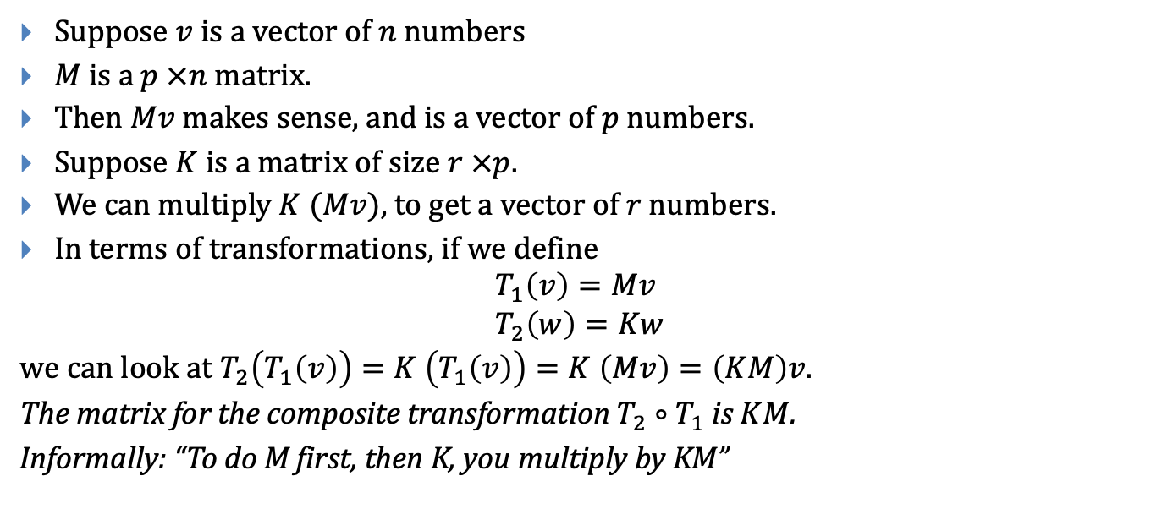
Suppose $v$ is a vector of $n$ numbers
$M$ is a $p ×n$ matrix.
Then $Mv$ makes sense, and is a vector of $p$ numbers.
Suppose $K$ is a matrix of size $r ×p$.
We can multiply $K (Mv)$, to get a vector of $r$ numbers.
In terms of transformations, if we define
$$T_{1}\left(v\right)=Mv \\ T_{2}\left(w\right)=Kw$$
we can look at $T_{2}\left(T_{1}\left(v\right)\right)=K \left(T_{1}\left(v\right)\right)=K \left(Mv\right)=\left(KM\right)v$.
The matrix for the composite transformation $T_{2}∘T_{1}$is $KM$.
Informally: “To do M first, then K, you multiply by KM”

Slide 23
Overview
Examples of transformations and their uses
Points and vectors
A special kind of transformation
The dot product and matrix product
Matrix transformations
Composition of matrix transformations
Inverse transformations; inverse matrices
Building specific transformations
What about translation

Slide 24
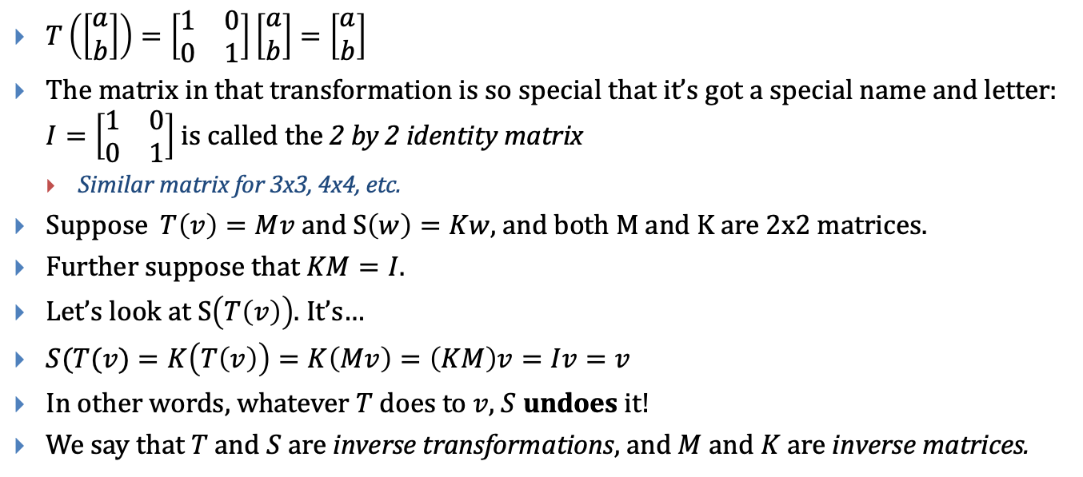
Let’s look at a special matrix transformation
$T\left(\left[\begin{aligned}a \\ b\end{aligned}\right]\right)=\left[\begin{matrix}1 & 0 \\ 0 & 1\end{matrix}\right]\left[\begin{aligned}a \\ b\end{aligned}\right]=\left[\begin{aligned}a \\ b\end{aligned}\right]$
The matrix in that transformation is so special that it’s got a special name and letter: $I=\left[\begin{matrix}1 & 0 \\ 0 & 1\end{matrix}\right]$ is called the 2 by 2 identity matrix
Similar matrix for 3x3, 4x4, etc.
Suppose $T\left(v\right)=Mv$ and S$\left(w\right)=Kw$, and both M and K are 2x2 matrices.
Further suppose that $KM=I$.
Let’s look at $S\left(T\left(v\right)\right)$. It’s…
$S(T(v)=K\left(T\left(v\right)\right)=K\left(Mv\right)=\left(KM\right)v=Iv=v$
In other words, whatever $T$ does to $v$, $S$ undoes it!
We say that $T$ and $S$ are inverse transformations, and $M$ and $K$ are inverse matrices.

Slide 25
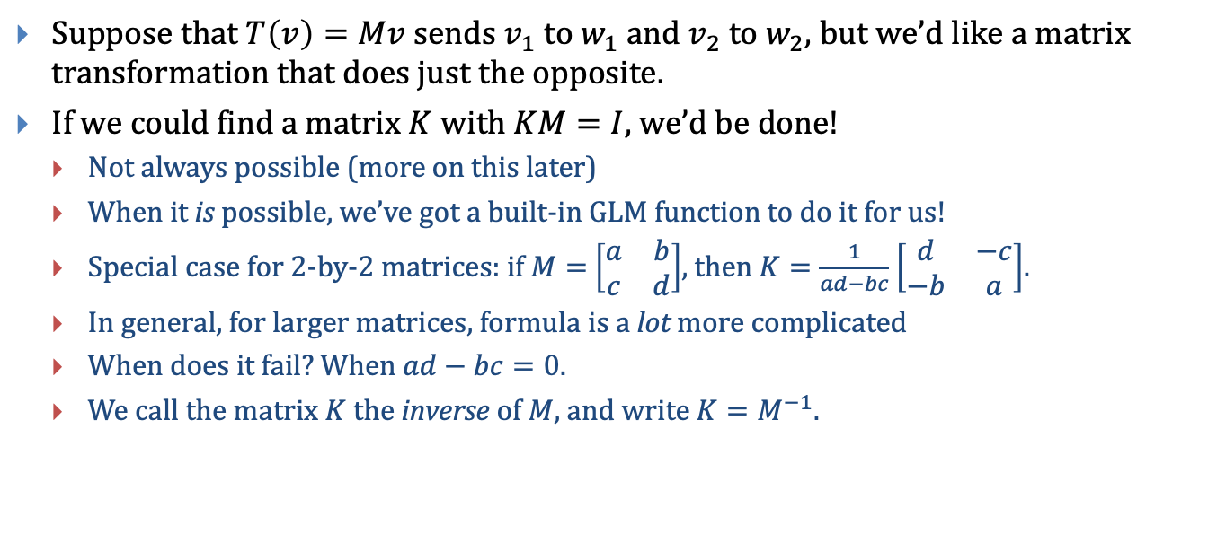
Inverses
Suppose that $T\left(v\right)=Mv$ sends $v_{1}$ to $w_{1}$ and $v_{2}$ to $w_{2}$, but we’d like a matrix transformation that does just the opposite.
If we could find a matrix $K$ with $KM=I$, we’d be done!
Not always possible (more on this later)
When it is possible, we’ve got a built-in GLM function to do it for us!
Special case for 2-by-2 matrices: if $M=$ $\left[\begin{matrix}a & b \\ c & d\end{matrix}\right]$, then $K=\frac{1}{ad−bc}$ $\left[\begin{matrix}d & −c \\ −b & a\end{matrix}\right]$.
In general, for larger matrices, formula is a lot more complicated
When does it fail? When $ad−bc=0$.
We call the matrix $K$ the inverse of $M$, and write $K=M^{−1}.$

Slide 26
Overview
Examples of transformations and their uses
Points and vectors
A special kind of transformation
The dot product and matrix product
Matrix transformations
Composition of matrix transformations
Inverse transformations; inverse matrices
Building specific transformations
What about translation

Slide 27
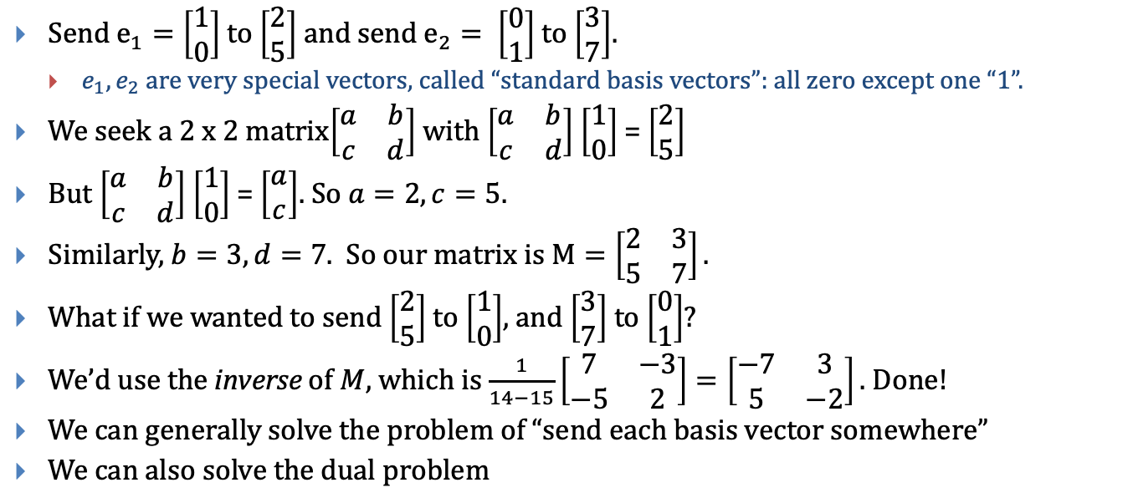
Suppose we want to build a transformation
Send $e_{1}=\left[\begin{aligned}1 \\ 0\end{aligned}\right]$ to $\left[\begin{aligned}2 \\ 5\end{aligned}\right]$ and send $e_{2}= \left[\begin{aligned}0 \\ 1\end{aligned}\right]$ to $\left[\begin{aligned}3 \\ 7\end{aligned}\right]$.
$e_{1},e_{2}$ are very special vectors, called “standard basis vectors”: all zero except one “1”.
We seek a 2 x 2 matrix$\left[\begin{matrix}a & b \\ c & d\end{matrix}\right]$ with $\left[\begin{matrix}a & b \\ c & d\end{matrix}\right]$ $\left[\begin{aligned}1 \\ 0\end{aligned}\right]$ = $\left[\begin{aligned}2 \\ 5\end{aligned}\right]$
But $\left[\begin{matrix}a & b \\ c & d\end{matrix}\right]$ $\left[\begin{aligned}1 \\ 0\end{aligned}\right]$ = $\left[\begin{aligned}a \\ c\end{aligned}\right]$. So $a=2, c=5.$
Similarly, $b=3, d=7.$ So our matrix is $M=\left[\begin{matrix}2 & 3 \\ 5 & 7\end{matrix}\right].$
What if we wanted to send $\left[\begin{aligned}2 \\ 5\end{aligned}\right]$ to $\left[\begin{aligned}1 \\ 0\end{aligned}\right]$, and $\left[\begin{aligned}3 \\ 7\end{aligned}\right]$ to $\left[\begin{aligned}0 \\ 1\end{aligned}\right]$?
We’d use the inverse of $M$, which is $\frac{1}{14−15}\left[\begin{matrix}7 & −3 \\ −5 & 2\end{matrix}\right]=\left[\begin{matrix}−7 & 3 \\ 5 & −2\end{matrix}\right].$ Done!
We can generally solve the problem of “send each basis vector somewhere”
We can also solve the dual problem

Slide 28
Overview
Examples of transformations and their uses
Points and vectors
A special kind of transformation
The dot product and matrix product
Matrix transformations
Composition of matrix transformations
Inverse transformations; inverse matrices
Building specific transformations
What about translation

Slide 29
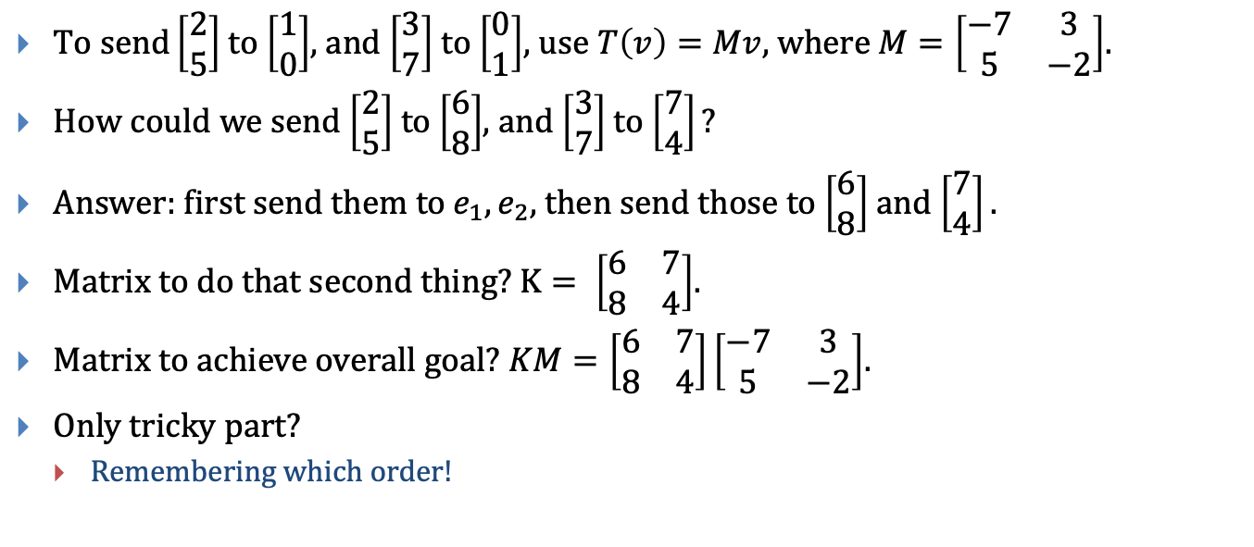
T$o send\left[\begin{aligned}2 \\ 5\end{aligned}\right]$ to $\left[\begin{aligned}1 \\ 0\end{aligned}\right]$, and $\left[\begin{aligned}3 \\ 7\end{aligned}\right]$ to $\left[\begin{aligned}0 \\ 1\end{aligned}\right]$, use $T\left(v\right)=Mv,$ where $M=\left[\begin{matrix}−7 & 3 \\ 5 & −2\end{matrix}\right]$.
How could we send $\left[\begin{aligned}2 \\ 5\end{aligned}\right]$ to $\left[\begin{aligned}6 \\ 8\end{aligned}\right]$, and $\left[\begin{aligned}3 \\ 7\end{aligned}\right]$ to $\left[\begin{aligned}7 \\ 4\end{aligned}\right]?$
Answer: first send them to $e_{1}, e_{2},$then send those to $\left[\begin{aligned}6 \\ 8\end{aligned}\right]$ and $\left[\begin{aligned}7 \\ 4\end{aligned}\right].$
Matrix to do that second thing? $K= \left[\begin{matrix}6 & 7 \\ 8 & 4\end{matrix}\right]$.
Matrix to achieve overall goal? $KM=\left[\begin{matrix}6 & 7 \\ 8 & 4\end{matrix}\right]\left[\begin{matrix}−7 & 3 \\ 5 & −2\end{matrix}\right]$.
Only tricky part?
Remembering which order!

Slide 30
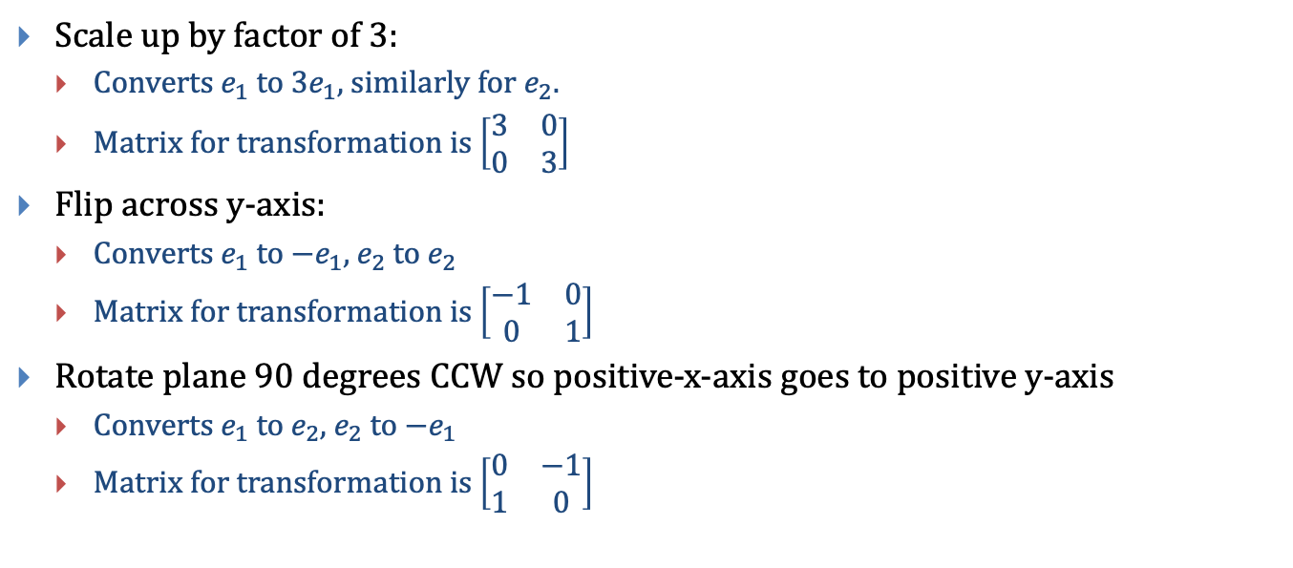
Concrete examples
Scale up by factor of 3:
Converts $e_{1}$ to $3e_{1},$ similarly for $e_{2}.$
Matrix for transformation is $\left[\begin{matrix}3 & 0 \\ 0 & 3\end{matrix}\right]$
Flip across y-axis:
Converts $e_{1}$ to $−e_{1},$ $e_{2}$ to $e_{2}$
Matrix for transformation is $\left[\begin{matrix}−1 & 0 \\ 0 & 1\end{matrix}\right]$
Rotate plane 90 degrees CCW so positive-x-axis goes to positive y-axis
Converts $e_{1}$ to $e_{2},$ $e_{2}$ to ${−e}_{1}$
Matrix for transformation is $\left[\begin{matrix}0 & −1 \\ 1 & 0\end{matrix}\right]$

Slide 31
Overview
Examples of transformations and their uses
Points and vectors
A special kind of transformation
The dot product and matrix product
Matrix transformations
Composition of matrix transformations
Inverse transformations; inverse matrices
Building specific transformations
What about translation

Slide 32
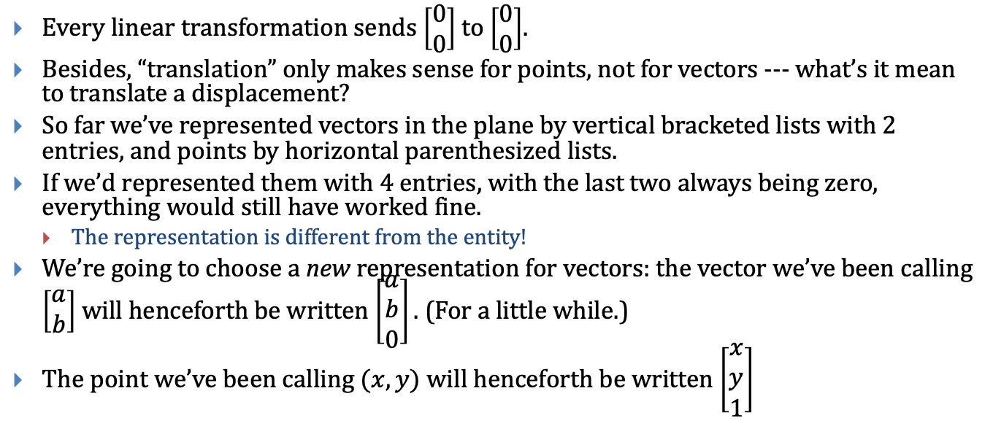
What about translation?
Every linear transformation sends $\left[\begin{aligned}0 \\ 0\end{aligned}\right]$ to $\left[\begin{aligned}0 \\ 0\end{aligned}\right]$.
Besides, “translation” only makes sense for points, not for vectors --- what’s it mean to translate a displacement?
So far we’ve represented vectors in the plane by vertical bracketed lists with 2 entries, and points by horizontal parenthesized lists.
If we’d represented them with 4 entries, with the last two always being zero, everything would still have worked fine.
The representation is different from the entity!
We’re going to choose a new representation for vectors: the vector we’ve been calling $\left[\begin{aligned}a \\ b\end{aligned}\right]$ will henceforth be written $\left[\begin{aligned}a \\ b \\ 0\end{aligned}\right].$ (For a little while.)
The point we’ve been calling $(x, y)$ will henceforth be written $\left[\begin{aligned}x \\ y \\ 1\end{aligned}\right]$

Slide 33
These are called “homogeneous coordinates”
Vectors (in the plane) are “all vectors in 3-space with last coordinate 0”
Points (in the plane) are “all vectors in 3-space with last coordinate 1”
All other vectors in 3-space have no meaning (yet).
What happens if we take the difference of two points? We get last coord = 0, so it’s a vector!
What about the sum of a point and a vector? Last coord = 1, so it’s a point!
This new representation captures all our old rules!
Dot product: we’ll only use it for vectors, so the extra ”0” won’t matter.

Slide 34
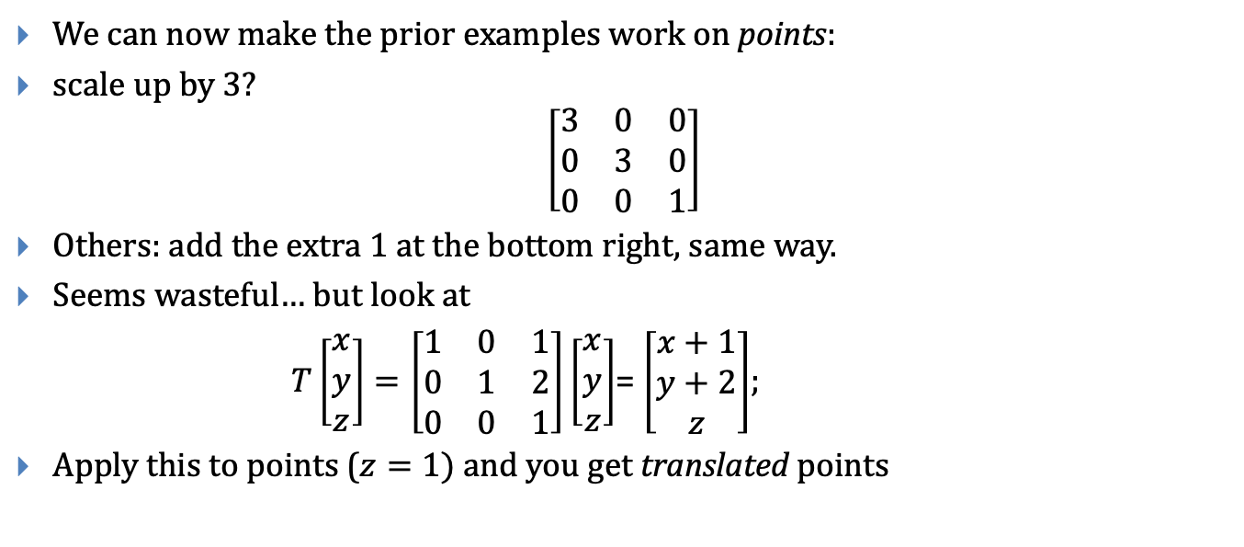
What do homogeneous coordinates give us?
We can now make the prior examples work on points:
scale up by 3?
$$\left[\begin{matrix}3 & 0 & 0 \\ 0 & 3 & 0 \\ 0 & 0 & 1\end{matrix}\right]$$
Others: add the extra 1 at the bottom right, same way.
Seems wasteful… but look at
$T\left[\begin{aligned}x \\ y \\ z\end{aligned}\right]=\left[\begin{matrix}1 & 0 & 1 \\ 0 & 1 & 2 \\ 0 & 0 & 1\end{matrix}\right]\left[\begin{aligned}x \\ y \\ z\end{aligned}\right]$= $\left[\begin{aligned}x+1 \\ y+2 \\ z\end{aligned}\right]$;
Apply this to points ($z=1)$ and you get translated points

Slide 35
Whew!
We’re using 3 x 3 matrices to do both linear transformations of vectors in the plane, AND more general (“affine”) transformations of points in the plane
What these matrices mean when we get a third coordinate that’s not 0 or 1? Nothing…
Yet. It’ll turn out to be useful later
By long tradition, the extra coordinate is called w

Slide 36
Overview of next segment
Concrete examples of transforms
Example applications in modeling of complex assemblies

Slide 37
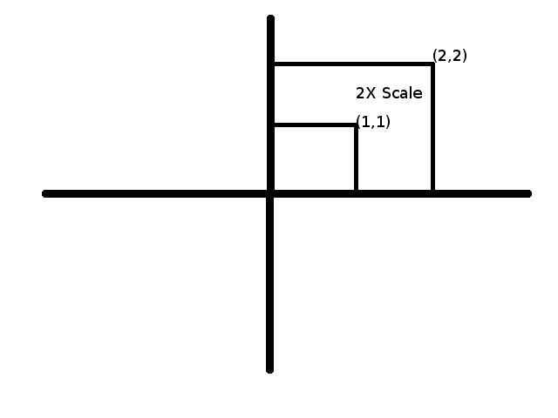
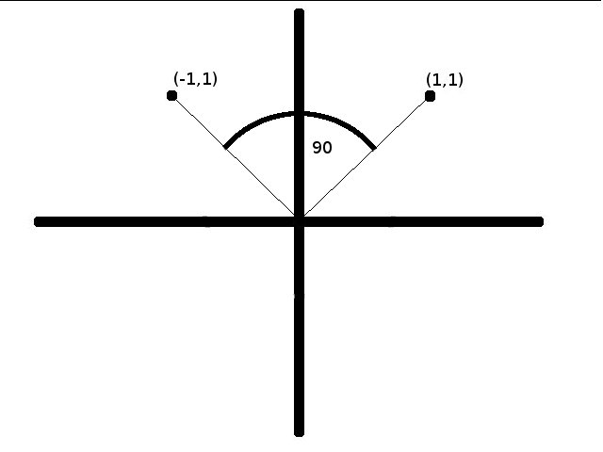
Linear Transformations (4/4)
Graphical use: transformations of points around the origin (leaves the origin invariant)
These include Scaling and Rotations
Any linear transformation of a point will result in another point in the same coordinate system, transformed about the origin
Note: Translation, by its very nature, is not linear!

Slide 38
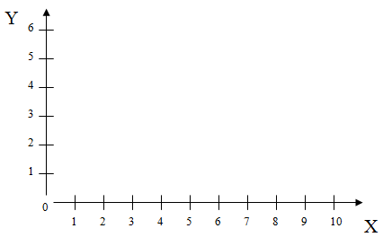

Scaling in 2D (1/2)
Scale x by 3, y by 2 (S_{x} = 3, S_{y} = 2)
v = (original vertex); v’ = (new vertex)
v’ = Sv
Derive S by determining how e₁ and e₂ should be transformed
(scale in X by S_{x})
(scale in Y by S_{y})
Thus we obtain
Side effect: House shifts position relative to origin
Notes:
Do the same for y

Slide 39
Scaling in 2D (2/2)
S is a diagonal matrix; we can quickly check using matrix multiplication that our derivation is correct:
S multiplies each coordinate of v by the appropriate scaling factor, as expected
In general, the i^{th} entry of Dv, where D is diagonal, is (D[i,i] * v[i]), product of two scalars
Properties of scaling to look out for:
Does not preserve angles between lines in the plane (except when scaling is uniform, i.e. s_{x} = s_{y})
If the object doesn’t start at the origin, scaling will move it closer to or farther from the origin (often not desired)

Slide 40
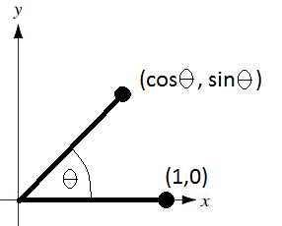
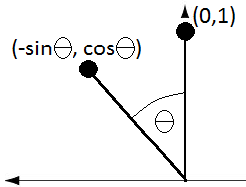
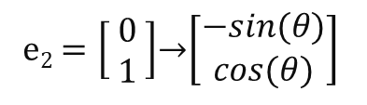
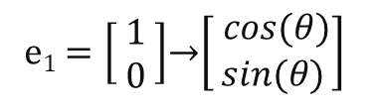
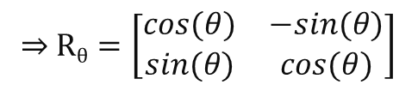
Rotation in 2D (1/2)
Rotate by θ about the origin
v’ = R_{θ}v, where
v = (original vertex)
v’ = (new vertex)
Derive R_{θ} by determining how e₁ and e₂ should be transformed:
e₁$=\left[\begin{matrix} 1 \\ 0\end{matrix}\right]$→$\left[\begin{aligned} cos⁡(θ) \\ sin⁡(θ)\end{aligned}\right]$
(first column of R_{θ})
e₂$=\left[\begin{aligned} 0 \\ 1\end{aligned} \right]$→$\left[\begin{aligned}−sin⁡(θ) \\ cos⁡(θ)\end{aligned}\right]$
(second column of R_{θ})
⇒ R$θ=\left[\begin{matrix}cos⁡(θ) & −sin(θ) \\ sin⁡(θ) & cos⁡(θ)\end{matrix}\right]$

Slide 41


Rotation in 2D (2/2)
Let’s try matrix-vector multiplication
R_{θ}v =
Other properties of rotation:
Preserves lengths in objects and angles between parts of objects (rigid-body rotation)
This is rotation about the origin, not around the center of the object. For objects not centered at the origin, such a rotation will “translate” the center of the object!
x’ = x cos($θ$) – y sin($θ$)
y’ = x sin($θ$) + y cos($θ$)

Slide 42



Transformations Homogenized
Let’s homogenize our all matrices! Doesn’t affect linearity of scaling and rotation
Our new transformation matrices look like this…
Note: These transformations are called affine transformations, which means they preserve ratios of distances between points on a straight line (but not necessarily (0, 0) )
Transformation | Matrix
Scaling
Rotation
Translation
$$\left[\begin{matrix}sx & 0 & 0 \\ 0 & sy & 0 \\ 0 & 0 & 1\end{matrix}\right]$$
$$\left[\begin{matrix}cos⁡(θ) & −sin⁡(θ) & 0 \\ sin(θ) & cos⁡(θ) & 0 \\ 0 & 0 & 1\end{matrix}\right]$$
$$\left[\begin{matrix}1 & 0 & dx \\ 0 & 1 & dy \\ 0 & 0 & 1\end{matrix}\right]$$

Slide 43
Building blocks
Translation, rotation, and scaling are great building blocks
With (quite a lot of) work, you can express any affine transformation through a sequence of these
Often much easier just to say “what does the composite transformation do to a few simple points or vectors?” and then use the general approach from section 1.

Slide 44
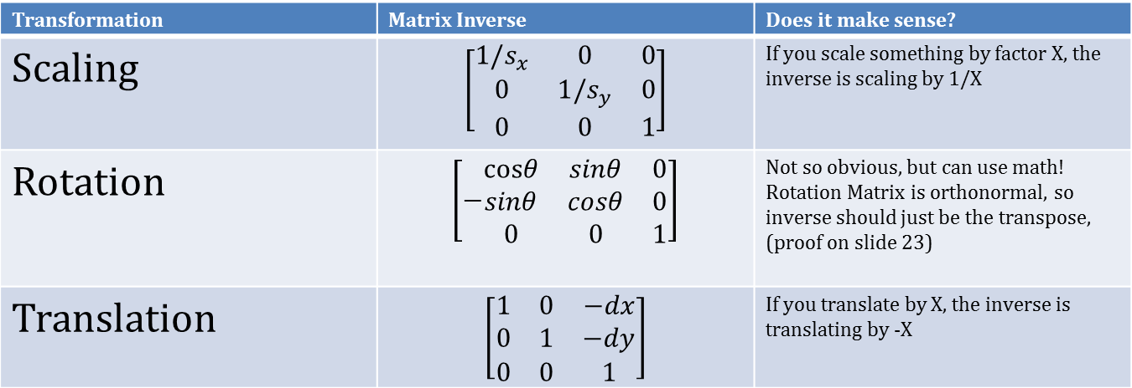
Inverses
When we want to undo a transformation, we’ll need to find the matrix’s inverse.
Thanks to homogenization, all our building blocks are invertible!
Transformation | Matrix Inverse | Does it make sense?
Scaling |  | If you scale something by factor a, the inverse is scaling by 1/a
Rotation |  | Inverse of rotation by θ is rotation by –θ. The properties sin(-θ) = -sin(θ) and cos(-θ) = cos(θ) give this matrix. Also, the matrix is orthonormal, so inverse is just the transpose (see next slide).
Translation |  | If you translate by x, the inverse is translation by -x

Slide 45
Applications of affine transformations
Some uses we’ll see later:
Placing sub-objects in parent’s coordinate system to construct hierarchical scene graph
Transforming primitives in their own coordinate systems
View volume normalization
Mapping arbitrary view volume into canonical view volume along z-axis
Parallel (orthographic, oblique) and perspective projections
Perspective transformation (turn viewing pyramid into a cuboid to turn perspective projection into parallel projection) after perspective foreshortening

Slide 46
Composition of Transformations (2D) (2/2)
We can now form compositions of transformation matrices to form a more complex transformation
For example, TRSv, which scales a point, then rotates it, then translates it:
Note that we apply the matrices in sequence right to left. We can use associativity to compose them first; it is often useful to be able to apply a single matrix if, for example, we want to use it to transform many points at once
Important: order matters! Matrix multiplication is NOT commutative.
Be sure to check out the Transformation Game at http://www.cs.brown.edu/exploratories/freeSoftware/repository/edu/brown/cs/exploratories/applets/transformationGame/transformation_game_guide.html
Let’s see an example…

Slide 47
Transformations in General are not Commutative
6
Translate by
x = 6, y = 0, then
rotate by 45º
5
4
3
2
1
0
1
2
3
4
5
6
7
8
9
10
Rotate by 45º,
then translate
by x = 6, y = 0
Y
6
5
4
3
2
1
0
1
2
3
4
5
6
7
8
9
10
X

Slide 48
Aside: Skewing/shearing
Y
6
5
“Skew” an object to the side, like shearing a card deck by displacing each card relative to the previous one
What physical situations mirror this behavior?
Squares become parallelograms; x-coordinates skew to right, y stays the same
Notice that the base of the house (at y = 1) remains horizontal but shifts right. Why?
4
3
2
1
0
1
2
3
4
5
6
7
8
9
10
X
2D non-homogeneous
2D homogeneous
Notes:
Size of matrix

Slide 49
Inverses Revisited
What is the inverse of a sequence of transformations?
(M₁M₂…M_{n})⁻¹ = M_{n}⁻¹M_{n-1}⁻¹…M₁⁻¹
Inverse of a sequence of transformations is the composition of the inverses of each transformation in reverse order!

Slide 50
Back to windowing Transformations (CG terminology)
Windowing transformation maps contents of 2D clip rectangle (“window”) to a “viewport” rectangle on the screen, e.g., interior canvas (“client area”) of a window manager’s window; also called window-to-viewport transformation
Sends rectangle with bounding coordinates (u₁ , v₁), (u₂ , v₂) to (x₁ , y₁), (x₂ , y₂)
The transformation matrix here is:

Slide 51
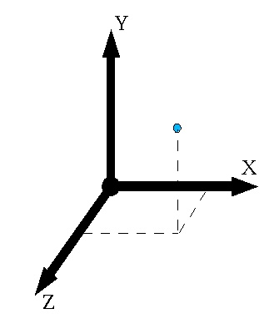
Dimension++ (3D!)
How should we treat geometric transformations in 3D?
Just add one more coordinate/axis!
A point is represented as
A matrix for a linear transformation T can be represented as
where e₃ is the standard basis vector along the z-axis,
But remember to use homogeneous coordinates! Embed scale and rotation matrices as upper left submatrices and translation vectors as upper right subvectors of the right column

Slide 52
Transformations in 3D
Transformation | Matrix | Comments
Scaling |  | Looks just like the 2D version. We just added an s_{z} term.
Rotation | (see next slide) | In 2D, only one axis of rotation; now there are infinitely many! Must take all into account. See next slide...
Translation |  | Similar to the 2D version, just with one more entry dz, representing change in the z-direction.

Slide 53
Rodrigues’s Formula…
Rotation by angle θ around vector u = [u_{x} u_{y} u_{z}]^{T}
Note: this is an arbitrary unit vector u in xyz-space
Here’s a not so friendly-looking rotation matrix
This is called the coordinate form of Rodrigues’s formula
Let’s try a different approach…

Slide 54
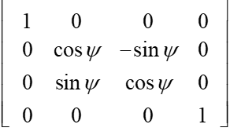
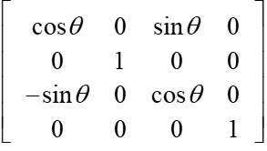
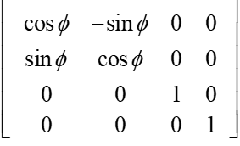
Euler angles (1/2)
Every rotation can be represented as the composition of 3 different angles of counter-clockwise rotation around 3 axes, namely
x axis in the yz plane by ψ; y axis in the zx plane by θ; z axis in the xy plane by ϕ
Also known as Euler angles, make problem of rotation much easier
Note these differ only in how the 3x3 submatrix is embedded in the homogeneous matrix, but the row-column order is different for R_{zx}
You can compose these matrices to form a composite rotation matrix
R_{yz}(ψ): rotation about x axis by ψ | R_{zx}(θ): rotation about y axis by θ | R_{xy}(ϕ): rotation about z axis by ϕ
Notes:
italic

Slide 55
Secret Sauce
Always write coordinates in the same (cyclic) order: xyz. So yzx, zxy are good, too.
”Rotation around x” is really “rotate +y towards +z”
”Rotation around y” is really “rotate +z towards +x”
”Rotation around z” is really “rotate +x towards +y”

Slide 56
Serious advice from someone who’s used rotations a lot
Use Rodrigues.

Slide 57
Inverses and Composition in 3D!
Inverses are once again parallel to their 2D versions…
Composition works exactly the same way…
Transformation | Inverse Matrix
Scaling
Rotation | R_{yz}⁻¹ (ψ) R_{zx}⁻¹(θ) R_{xy}⁻¹(ϕ)
Translation

Slide 58

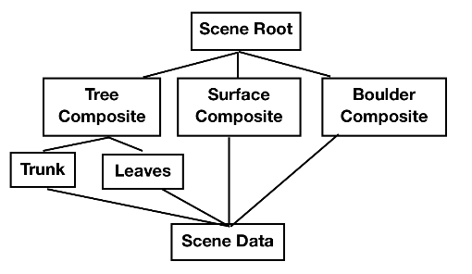
Transformations and the scene graph (1/5)
Scene Graph
Objects are typically composites:
3D scenes are often stored in a directed acyclic graph (DAG) called a scene graph
WPF (Windows Presentation Foundation)
Open Scene Graph (used in the Cave)
X3D ™ (VRML ™ was a precursor to X3D)
most game engines
Typical scene graph format:
objects (cubes, sphere, cone, polyhedra etc.):
stored as nodes (default: unit size at origin)
attributes (color, texture map, etc.): stored as separate nodes
Transformations: also nodes
ROBOT
upper body
lower body
stanchion
base
head
trunk
arm
arm
Juwal Bose: Creating a Simple 3D Endless Runner Game Using Three.js
Example scenegraph from a game engine

Slide 59
Transformations and the scene graph (2/5)
For your assignments use simplified format:
Attributes stored as a components of each object node (no separate attribute node)
A transform node affects its subtree
Only leaf nodes are graphical objects.
All internal nodes that are not transform nodes are object group nodes

Slide 60
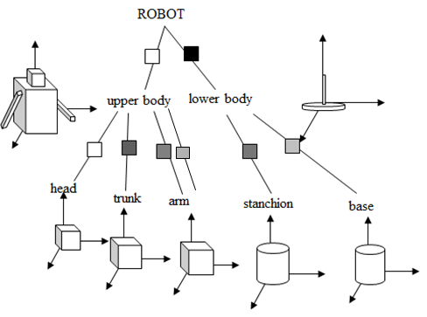
Transformations and the scene graph (3/5)
Step 1: Various transformations are applied to each of the leaves (object primitives—head, base, etc.)
Step 2: Transformations are then applied to groups of objects (form upper and lower body, etc…)
This format means that instead of designing new primitives for every single shape we need, we can just apply transformations to a smaller set of primitives to form complex composite 3D shapes
Represents a
transformation
Together the above hierarchy of transformations forms the “robot” scene as a whole

Slide 61
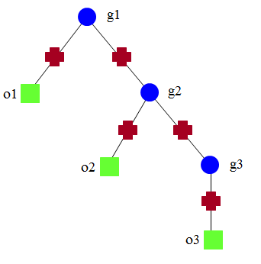
Transformations and the scene graph (4/5)
A cumulative transformation matrix (CTM) builds as you move up the tree
Note that higher level transformation matrices are appended to the front of the sequence
Example:
For object 1 (o1), CTM = M₁
For o2, CTM = M₂M₃
For o3, CTM = M₂M₄M₅
For a vertex v in o3, position in world coordinate system is CTM v = (M₂M₄M₅) v
M₁
M₂
M₃
M₄
M₅
object nodes (geometry)
transformation nodes
group nodes

Slide 62
Transformations and the scene graph (5/5)
You can easily reuse groups of objects (sub-trees in the scene graph) if they have been defined already
This might occur if you have multiple similar components to your scene. For example, the robot’s 2 arms
Here, group 3 has been used twice.
Transformations defined within group 3 itself do not change; there are different CTMs for each use of group 3 as a whole
T₀T₁ vs. T₀T₂T₄
root
group3
group1
obj4
obj3
obj1
group3
group2
obj2
group3

Slide 63
Further Reading
More information can be found in the textbook
Read Chapters 10 and 11 for more detail and advanced topics on transformations
Chapter 7 discusses the 2D/3D coordinate space geometry
Chapter 12 goes into more detail about some of the linear algebra involved in graphics

Slide 64
FIN

Slide 65
Two possible approaches to finding that
The “Andy” approach:
Move rectangle to origin
Scale down (nonuniformly) to unit square
Scale up to proportions of target rectangle
Move rectangle out to target location
The “Spike” approach
Send (u1, v1) to (1,0) and (u2, v2) to (0, 1)
Send (1, 0) to (x1, y1) and (0, 1) to (x2, y2)

